Slide 1
CBMS Data Warehousing and OLAP
ADVANDB S19
Amadora - Aquino - Choy

Slide 2
OVERVIEW
The Community Based Management System (CBMS) is a collection of various household information and data collected from the residents of the provinces of Palawan and Marinduque.
Provided with the CBMS database is the Data Dictionary which lists all of the tables, variables, and values used in the database
About CBMS

Slide 3
INTRO
For the second Major Course Output (MCO2) of the course ADVANDB, students will again use the CBMS dataset from the combined provinces of Palawan and Marinduque.
To design a dimensionality model for a data warehouse; to extract, transform and load the data from this dataset to the group’s newly created model.
To create an application utilizing OLAP queries such as roll-up, drilldown, slice, and dice operations on the created model which
Objectives of MCO2

Slide 4
Methodology
Design a new Model
Star/Snowflake/Constellation
Select tables to be used (Data Dictionary)
Supports OLAP queries
Relevant to certain organizations
Confirm ETL validity
Compare the created Schema and the original database’s result sets
Similar queries should produce similar results
Develop query application
Java
Demonstrate OLAP queries
Must satisfy purpose of the software
Perform ETL from the CBMS DB
Extract select data from the CBMS Dataset
Transform extracted data to match the created Model’s purpose
Load transformed data into the created Model
Generate OLAP queries
Queries which apply Rollup, Drill Down, Slice, and Dice on select information from the created schema
Similar queries but with varying constraints

Slide 5
Dimensional Model

Slide 6
Constellation Schema
The original CBMS database mostly had one to one data references (meaning only one or two dimensions at a time are referenced at most).
Transforming these data into a constellation would allow for more than one analytical view and extraction for data.
Transform the table into a multidimensional schema by considering certain categorical columns from a table as individual dimension tables and have the original table serve as a fact table referencing all the dimensions needed.
Schema and Issues

Slide 7
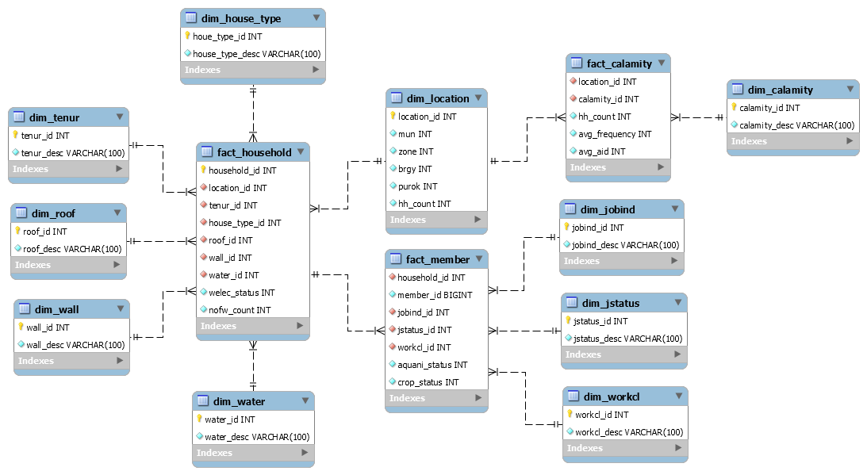

Slide 8
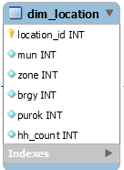
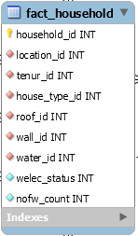
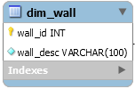




Household Fact Table
Dimensions

Slide 9
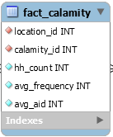
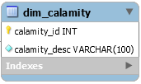
Calamity Fact Table
Dimensions

Slide 10

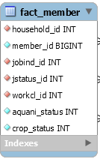

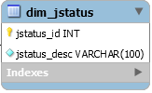
Member Fact Table
Dimensions

Slide 11
ETL Process

Slide 12
ETL Tool
The group decided to create their own ETL tool using MySQL.
The ETL process was performed on a complete data dump containing both Palawan and Marinduque data sets.
Extract select data from the CBMS Dataset. Transform extracted data to match the created Model’s purpose. Load transformed data into the created Model
Data for the Dimension Tables were taken from the Data Dictionary.
ETL Process Performed by the Group

Slide 13
Location Dimension Table
INSERT INTO constellation.dim_location(mun, zone, brgy, purok, hh_count)
SELECT DISTINCT mun, zone, brgy, purok, COUNT(id) AS 'hh_count'
FROM db_hpq.hpq_hh
GROUP BY mun, zone, brgy, purok;

Slide 14
Household Fact Table
INSERT INTO constellation.fact_household
SELECT H.id, L.location_id, IFNULL(H.tenur, 0), H.house_type,
CASE
WHEN H.roof = 1 THEN 1
WHEN H.roof = 2 THEN 5
WHEN H.roof = 3 THEN 3
WHEN H.roof = 4 THEN 2
WHEN H.roof = 5 THEN 6
WHEN H.roof = 6 THEN 4
WHEN H.roof = 7 THEN 7
END AS 'roof',
CASE
WHEN H.wall = 1 THEN 1
WHEN H.wall = 2 THEN 5
WHEN H.wall = 3 THEN 3
WHEN H.wall = 4 THEN 2
WHEN H.wall = 5 THEN 6
WHEN H.wall = 6 THEN 4
WHEN H.wall = 7 THEN 7
END AS 'wall',
H.water, IFNULL(H.welec, 2), H.nofw
FROM db_hpq.hpq_hh H
INNER JOIN constellation.dim_location L
ON H.mun = L.mun AND H.zone = L.zone AND H.brgy = L.brgy AND H.purok = L.purok
GROUP BY H.id;

Slide 15
Calamity Fact Table
INSERT INTO constellation.fact_calamity
SELECT L.location_id, <calamity_id>, COUNT(L.location_id), AVG(H.calam<calamity id>_hwmny),
2 - AVG(H.calam<calamity id>__aid)
FROM db_hpq.hpq_hh H
INNER JOIN constellation.dim_location L
ON H.mun = L.mun AND H.zone = L.zone AND H.brgy = L.brgy AND H.purok = L.purok
WHERE H.calam<calamity id> = 1
GROUP BY L.location_id;

Slide 16
Member Fact Table
INSERT INTO constellation.fact_member
SELECT M.id, M.memno,
IFNULL(M.jobind, 0) AS 'jobind',
IFNULL(M.jstatus, 0) AS 'jstatus',
IFNULL(M.workcl, 0) AS 'workcl',
IF(A.id IS NOT NULL, TRUE, FALSE) AS 'aquani_status',
IF(C.id IS NOT NULL, TRUE, FALSE) AS 'crop_status'
FROM (SELECT id, memno, jobind, jstatus, workcl FROM db_hpq.hpq_mem) M
LEFT JOIN (SELECT hpq_hh_id, id FROM db_hpq.hpq_aquani) AS A
ON M.id = A.hpq_hh_id AND M.memno = A.id
LEFT JOIN (SELECT hpq_hh_id, id FROM db_hpq.hpq_crop) AS C
ON M.id = C.hpq_hh_id AND M.memno = C.id
WHERE M.id IN (SELECT household_id FROM constellation.fact_household)
ORDER BY M.id;

Slide 17
OLAP Queries

Slide 18
Base Query – Average Type of Household Factors per Location per House Type
SELECT L.location_id, HT.house_type_desc,
COUNT(DISTINCT(H.household_id)) AS 'hh_count',
AVG(H.roof_id) AS 'roof_avg',
AVG (H.wall_id) AS 'wall_avg',
AVG(H.water_id) AS 'water_avg',
2 - AVG(H.welec_status) AS 'welec_avg'
FROM (fact_household H)
INNER JOIN dim_location AS L ON H.location_id = L.location_id
LEFT JOIN dim_house_type AS HT ON H.house_type_id = HT.house_type_id
GROUP BY L.location_id, HT.house_type_desc
ORDER BY L.location_id ASC, HT.house_type_desc ASC;

Slide 19
Rollup Query – Average Type of Household Factors per Location
SELECT L.location_id,
COUNT(DISTINCT(H.household_id)) AS 'hh_count',
AVG(H.roof_id) AS 'roof_avg',
AVG (H.wall_id) AS 'wall_avg',
AVG(H.water_id) AS 'water_avg',
2 - AVG(H.welec_status) AS 'welec_avg'
FROM (fact_household H)
INNER JOIN dim_location AS L ON H.location_id = L.location_id
GROUP BY L.location_id

Slide 20
Rollup Query – Average Type of Household Factors per House Type
SELECT HT.house_type_desc,
COUNT(DISTINCT(H.household_id)) AS 'hh_count',
AVG(H.roof_id) AS 'roof_avg',
AVG (H.wall_id) AS 'wall_avg',
AVG(H.water_id) AS 'water_avg',
2 - AVG(H.welec_status) AS 'welec_avg'
FROM (fact_household H)
INNER JOIN dim_location AS L ON H.location_id = L.location_id
LEFT JOIN dim_house_type AS HT ON H.house_type_id = HT.house_type_id
GROUP BY HT.house_type_desc,

Slide 21
Rollup Query – Average Type of Household Factors per Tenur Type
SELECT T.tenur_desc,
COUNT(DISTINCT(H.household_id)) AS 'hh_count',
AVG(H.roof_id) AS 'roof_avg',
AVG (H.wall_id) AS 'wall_avg',
AVG(H.water_id) AS 'water_avg',
2 - AVG(H.welec_status) AS 'welec_avg
FROM (fact_household H)
INNER JOIN dim_location AS L ON H.location_id = L.location_id
LEFT JOIN dim_tenur AS T ON H.tenur_id = T.tenur_id
GROUP BY T.tenur_desc;

Slide 22
Drill Down Query – Average Type of Household Factors per Location per House Type per Tenur Type
SELECT L.location_id, HT.house_type_desc, T.tenur_desc,
COUNT(DISTINCT(H.household_id)) AS 'hh_count',
AVG(H.roof_id) AS 'roof_avg',
AVG (H.wall_id) AS 'wall_avg',
AVG(H.water_id) AS 'water_avg',
2 - AVG(H.welec_status) AS 'welec_avg'
FROM (fact_household H)
INNER JOIN dim_location AS L ON H.location_id = L.location_id
LEFT JOIN dim_house_type AS HT ON H.house_type_id = HT.house_type_id
LEFT JOIN dim_tenur AS T ON H.tenur_id = T.tenur_id
GROUP BY L.location_id, HT.house_type_desc, T.tenur_desc
ORDER BY L.location_id ASC, HT.house_type_desc ASC, T.tenur_desc ASC;

Slide 23
Drill Down Query – Average Type of Household Factors per Location per House Type per Tenur Type per Household
SELECT L.location_id, HT.house_type_desc, T.tenur_desc,
H.household_id, R.roof_desc, W.wall_desc, WA.water_desc, H.welec_status
FROM (fact_household H)
INNER JOIN dim_location AS L ON H.location_id = L.location_id
LEFT JOIN dim_house_type AS HT ON H.house_type_id = HT.house_type_id
LEFT JOIN dim_tenur AS T ON H.tenur_id = T.tenur_id
LEFT JOIN dim_roof AS R ON H.roof_id = R.roof_id
LEFT JOIN dim_wall AS W ON H.wall_id = W.wall_id
LEFT JOIN dim_water AS WA ON H.water_id = WA.water_id
GROUP BY L.location_id, HT.house_type_desc, T.tenur_desc, H.household_id
ORDER BY L.location_id ASC, HT.house_type_desc ASC, T.tenur_desc ASC, H.household_id ASC;

Slide 24
Slice and Dice Query – Average Type of Household Factors of Households Affected by “Bagyo” and did not Receive Aid
SELECT L.location_id,
COUNT(DISTINCT(H.household_id)) AS 'hh_count',
AVG(H.roof_id) AS 'roof_avg',
AVG (H.wall_id) AS 'wall_avg',
AVG(H.water_id) AS 'water_avg',
2 - AVG(H.welec_status) AS 'welec_avg'
FROM (fact_household H)
INNER JOIN dim_location AS C ON H.location_id = C.location_id
INNER JOIN dim_location AS L ON H.location_id = L.location_id
WHERE C.calamity_id = 1
AND C.avg_aid = 0
AND L.mun = 1
GROUP BY L.location_id;

Slide 25
Results and Analysis

Slide 26
Created OLAP Schema
SELECT location_id
FROM constellations.fact_calamity
WHERE calamity_id = 1;
2284 rows
Average of 0.038 seconds execution time per 5 runs
Original CBMS Dataset
SELECT L.location_id
FROM db_hpq.hpq_hh H
INNER JOIN constellation.dim_location L
ON H.mun = L.mun AND H.zone = L.zone AND H.brgy = L.brgy AND H.purok = L.purok
WHERE calam1 = 1
GROUP BY L.location_id;
2284 rows
Average of 19.1828 seconds execution time per 5 runs

Slide 27
Created OLAP Schema
SELECT L.location_id, HT.house_type_desc, T.tenur_desc, H.household_id, R.roof_desc, W.wall_desc, WA.water_desc, H.welec_status
FROM (fact_household H)
INNER JOIN dim_location AS L ON H.location_id = L.location_id
LEFT JOIN dim_house_type AS HT ON H.house_type_id = HT.house_type_id
LEFT JOIN dim_tenur AS T ON H.tenur_id = T.tenur_id
LEFT JOIN dim_roof AS R ON H.roof_id = R.roof_id
LEFT JOIN dim_wall AS W ON H.wall_id = W.wall_id
LEFT JOIN dim_water AS WA ON H.water_id = WA.water_id
GROUP BY L.location_id, HT.house_type_desc, T.tenur_desc, H.household_id
ORDER BY L.location_id ASC, HT.house_type_desc ASC, T.tenur_desc ASC, H.household_id ASC;
148277 rows
Average of 7.52818 seconds execution time per 5 runs
Original CBMS Dataset
SELECT L.location_id, HT.house_type_desc, T.tenur_desc, H.id, R.roof_desc, W.wall_desc, WA.water_desc, H.welec
FROM (db_hpq.hpq_hh H)
INNER JOIN constellation.dim_location L
ON H.mun = L.mun AND H.zone = L.zone AND H.brgy = L.brgy AND H.purok = L.purok
LEFT JOIN dim_house_type AS HT ON H.house_type = HT.house_type_id
LEFT JOIN dim_tenur AS T ON H.tenur = T.tenur_id
LEFT JOIN dim_roof AS R ON H.roof = R.roof_id
LEFT JOIN dim_wall AS W ON H.wall = W.wall_id
LEFT JOIN dim_water AS WA ON H.water = WA.water_id
GROUP BY L.location_id, HT.house_type_desc, T.tenur_desc, H.id
ORDER BY L.location_id ASC, HT.house_type_desc ASC, T.tenur_desc ASC, H.id ASC
148277 rows
Average of 55.428 seconds execution time per 5 runs

Slide 28
Original CBMS Dataset (with duplicates)
SELECT COUNT(id)
FROM db_hpq.hpq_hh;
148240 Rows
Original CBMS Dataset (w/o duplicates)
SELECT COUNT(DISTINCT(id))
FROM db_hpq.hpq_hh;
148227 Rows
Created OLAP Schema
SELECT COUNT(household_id)
FROM constellation.fact_household;
148227 Rows

Slide 29
Analysis Summary
No more NULL entries (transformed into their corresponding values)
No more duplicates (eliminated during the ETL process)
Performing OLAP queries on the newly created schema is much faster as compared to performing them on the original dataset
the usage of the data warehousing schema is more efficient due to the lower normalization required, which needs lesser joins and processes only the necessary data.
Comparisons with the Original CBMS Dataset

Slide 30
CONCLUSION
It is important to ensure that the schema being used is properly designed to handle and accommodate OLAP processes.
Extract, Transform, and Load (ETL) processes are heavily involved when it comes to creating applications which utilizes OLAP.
The ETL process must be accurate in a sense that the data should similar, if not exact, from the original mined database.
The only marginal differences accepted are the transformed values unaccounted for from the original database.
Summary of the findings

